Slide 1
MARITIME LAW ENFORCEMENT
IN THE WEST PHILIPPINE SEA
3rd Roundtable Discussion on Natural Resources
Astoria Plaza, Pasig City
26 January 2016

Slide 2
MARITIME LAW ENFORCEMENT IN THE WEST PHILIPPINE SEA
SCOPE OF PRESENTATION
Background
Authority
PCG Actions / Activities
Challenges
Way Forward

Slide 3
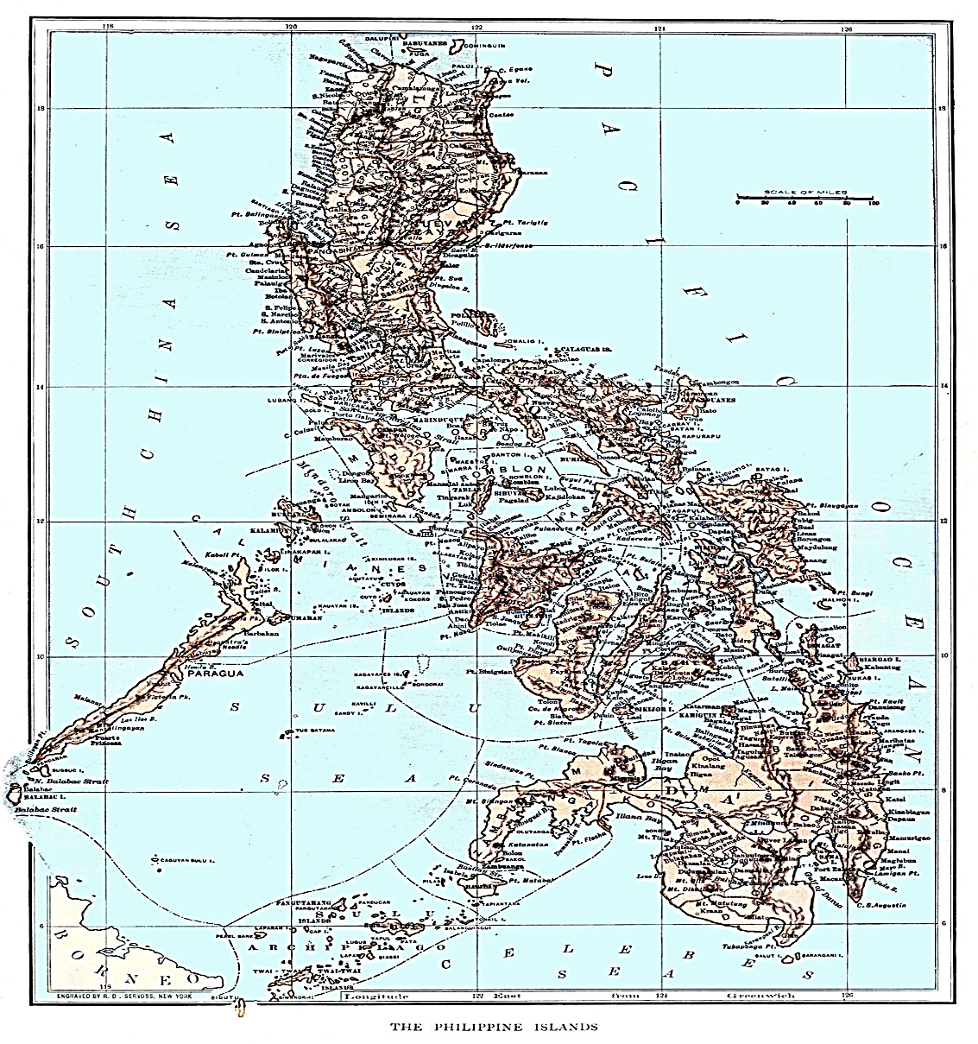
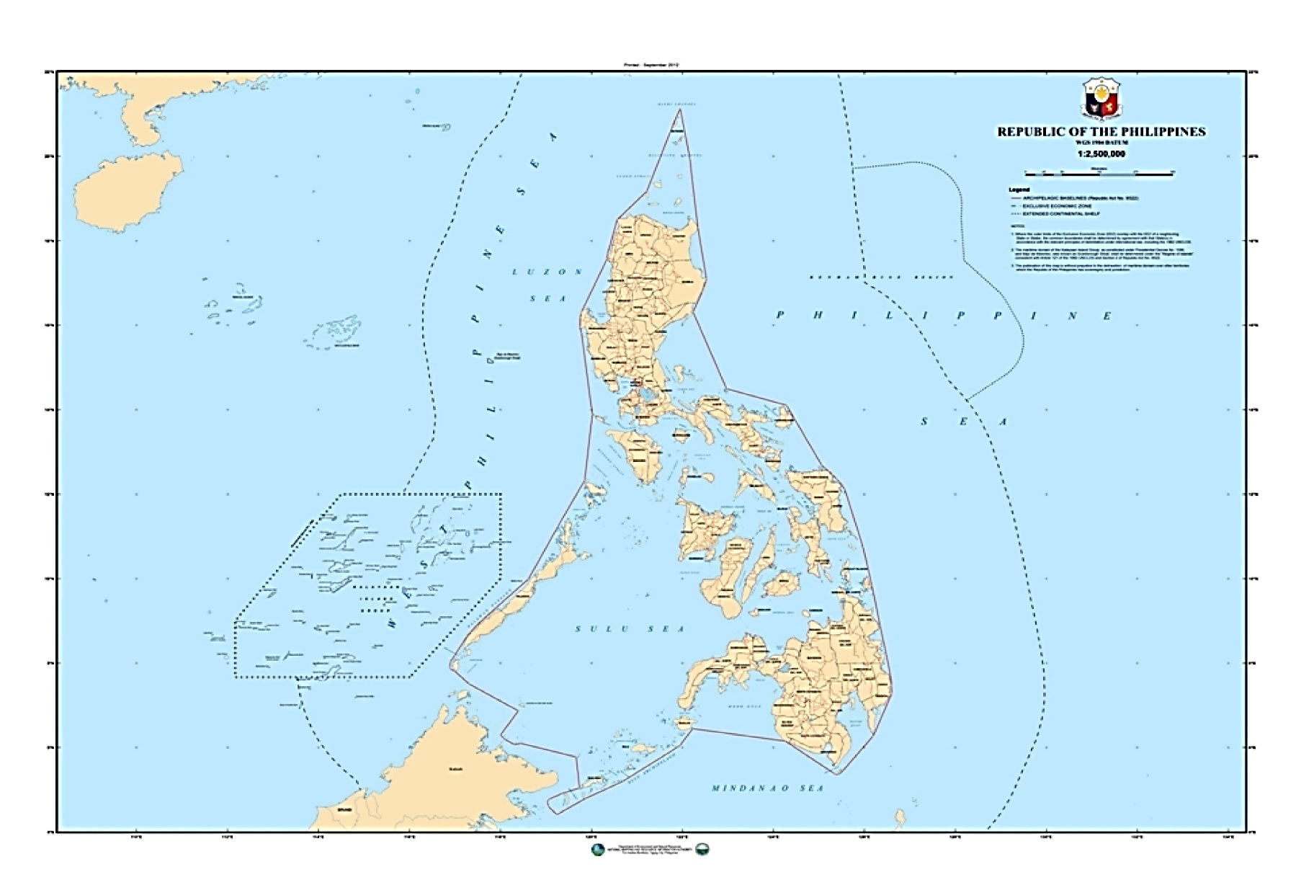
MARITIME LAW ENFORCEMENT IN THE WEST PHILIPPINE SEA
BACKGROUND
OLD PHILIPPINE MAP
NEW PHILIPPINE MAP (AO 29)

Slide 4
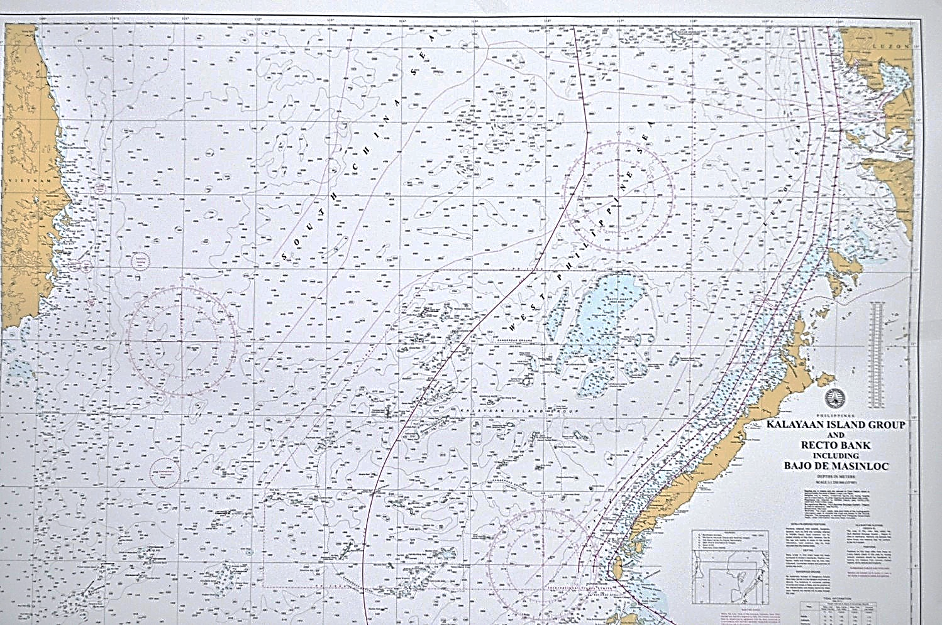
MARITIME LAW ENFORCEMENT IN THE WEST PHILIPPINE SEA
BACKGROUND
Map Provided by NAMRIA for Exclusive Use of PCG

Slide 5
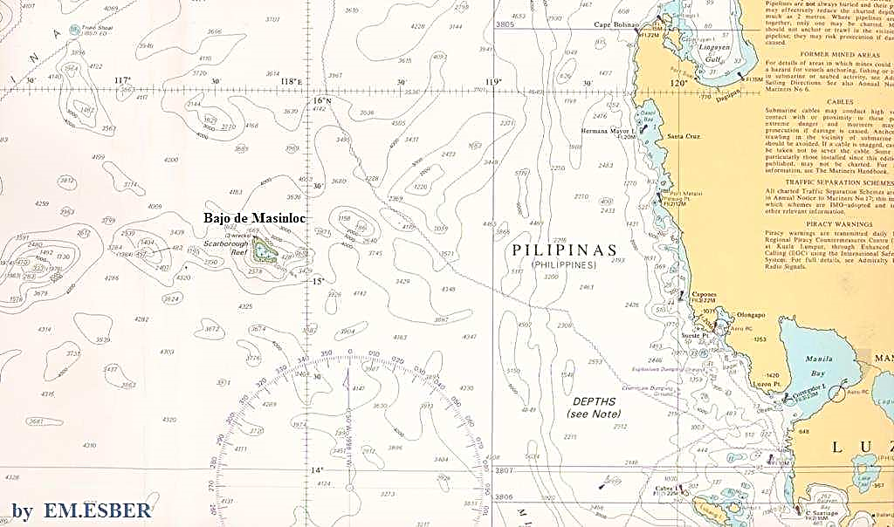
MARITIME LAW ENFORCEMENT IN THE WEST PHILIPPINE SEA
BACKGROUND
10 miles width
124 NM west of Luzon
9 – 10 meters depth
124 NM

Slide 6
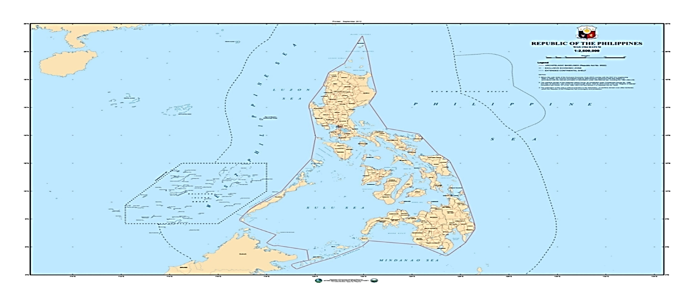
MARITIME LAW ENFORCEMENT IN THE WEST PHILIPPINE SEA
BACKGROUND
MAP OF SHOWING CG DISTRICT
HCGDNWLZN
HCGDNCR-CL
HCGDPAL

Slide 7
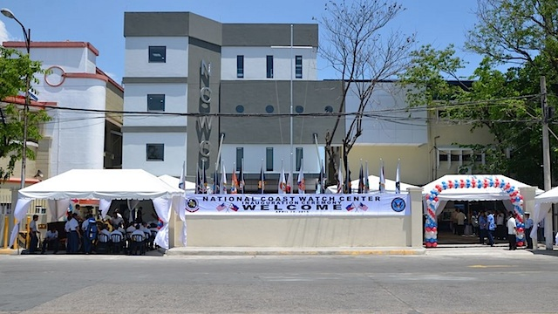
MARITIME LAW ENFORCEMENT IN THE WEST PHILIPPINE SEA
AUTHORITY
R.A. 9993
R.A. 8550 (As amended by R.A. 10654)
E.O. 154
E.O. 57
Memo from E.S. dated 06 May 2011
E.O. 60
Memo from E.S. Establishing ICC-WPS
BFAR-PCG MOA

Slide 8
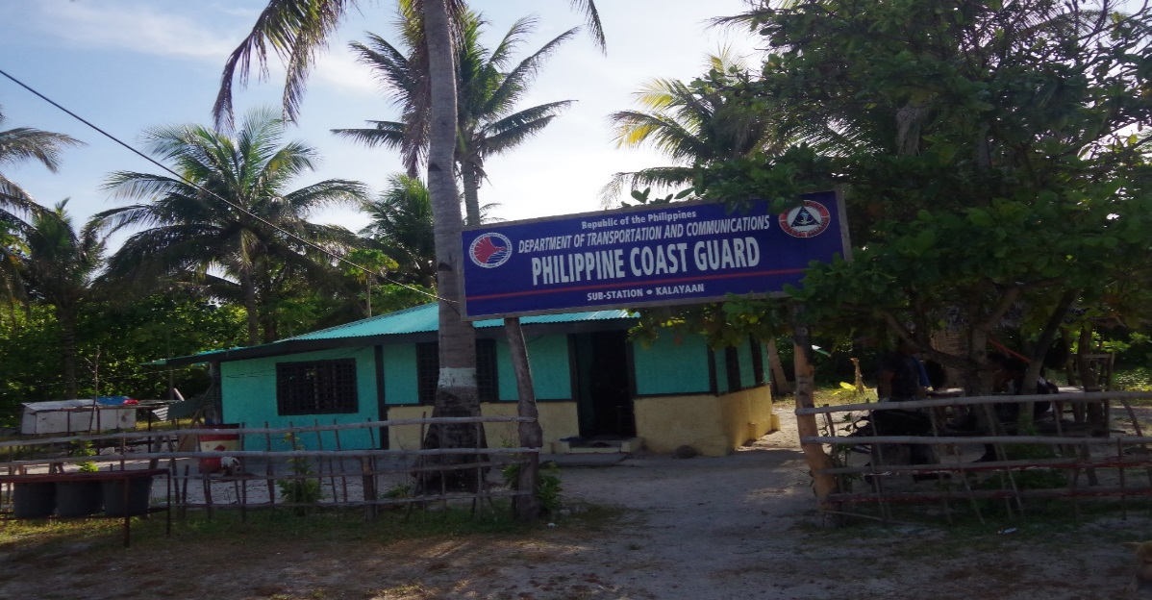
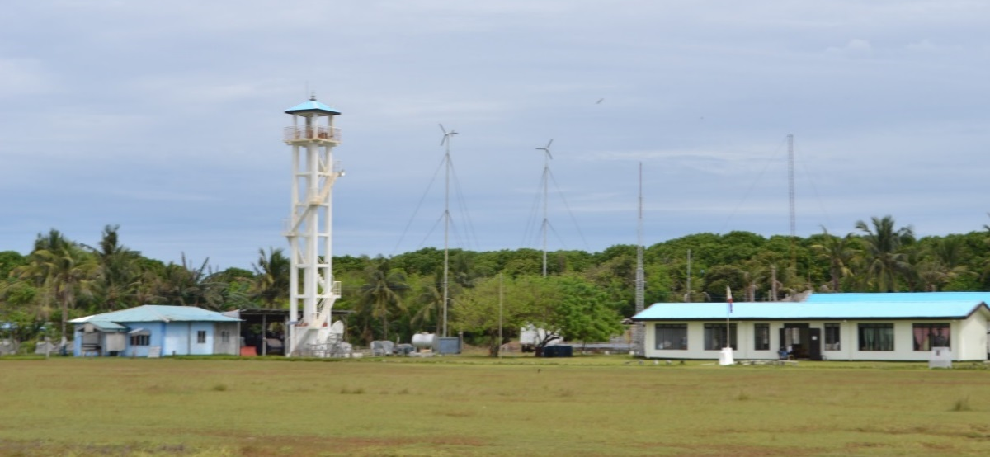
MARITIME LAW ENFORCEMENT IN THE WEST PHILIPPINE SEA
PCG ACTIONS / ACTIVITIES
Active Participation in Oil and Gas Platform Activities
Intelligence Gathering Operations
Monitoring IUU Fishing in WPS
Maritime Patrols by PCG and
BFAR MCS vessels
Establishment of CGSS and LS in
Pag-asa Island

Slide 9
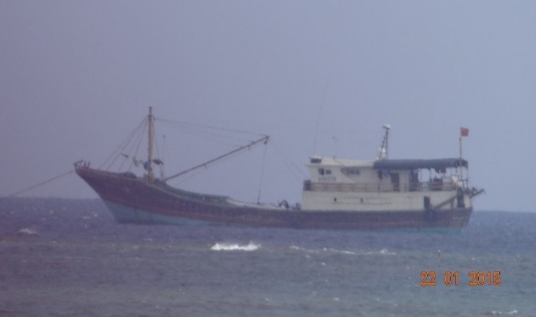
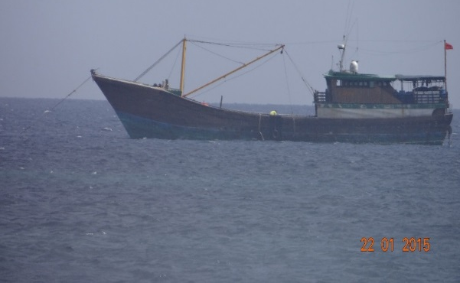
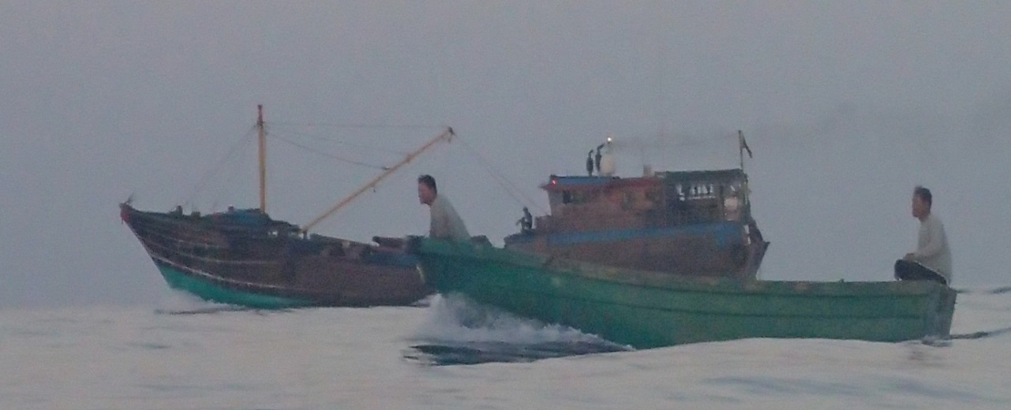
MARITIME LAW ENFORCEMENT IN THE WEST PHILIPPINE SEA
PCG ACTIONS / ACTIVITIES
MONITORING FOREIGN FISHING IN THE WPS

Slide 10
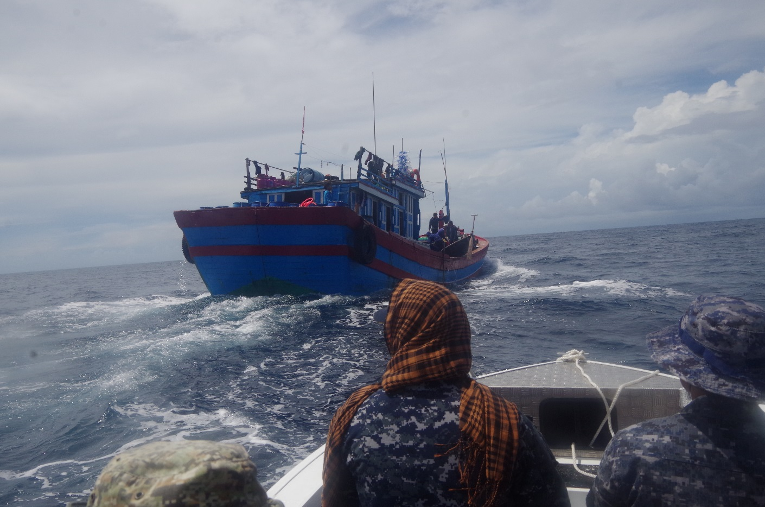
MARITIME LAW ENFORCEMENT IN THE WEST PHILIPPINE SEA
PCG ACTIONS / ACTIVITIES
MONITORING FOREIGN FISHING IN THE WPS

Slide 11
MARITIME LAW ENFORCEMENT IN THE WEST PHILIPPINE SEA
CHALLENGES
Vast WPS
Adverse Weather / Sea Conditions in the Area
Limited Capability of PCG Floating Assets

Slide 12
MARITIME LAW ENFORCEMENT IN THE WEST PHILIPPINE SEA
WAY FORWARD
PCG Capability Enhancement Program
Confidence Building Measures

Slide 13
MARITIME LAW ENFORCEMENT IN THE WEST PHILIPPINE SEA
END OF PRESENTATION
THANK YOU!

