Slide 1
40 YEARS OF SINO-PHILIPPINE RELATIONS FROM THE PERSPECTIVE OF BOTH STATE AND CIVIL SOCIETY
Presentation at Peking University
Foreign Languages Institute, 19 October 2015
Aileen S.P. Baviera
Asian Center
University of the Philippines

Slide 2
MAIN IDEAS
Traditional ties are quite deep, but most people today are not aware of this
Differences in political culture, ideology and residual Cold War-era mistrust influence state-level interactions
Territorial and maritime disputes have asymmetric value for Philippines and for China, which makes them difficult to address
Economic ties are stable and resilient, but of low volume and with relatively low impact on political relations

Slide 3
Poor crisis management has aggravated even small problems; while good crisis management can help mitigate even big ones
Information inadequacy and inaccuracy about each other leads to misperceptions, contributing to mutual antipathy
Strong people-to-people interaction will be crucial to better relations

Slide 4
Depth of traditional ties
Long-established trade relations (over 1000 years)
  Sung dynasty: Ma’i traders in Guangzhou in 982; Butuan trade missions (Moluccas – Butuan – Champa - China) since 1003; 16 envoys from early Philippine kingdoms from 1372-1424, including Sulu East King in 1417
  Ming porcelain finds all over PH
  Manila-Acapulco trade (1565 to 1815) bringing Chinese goods to Americas then Europe

Slide 5
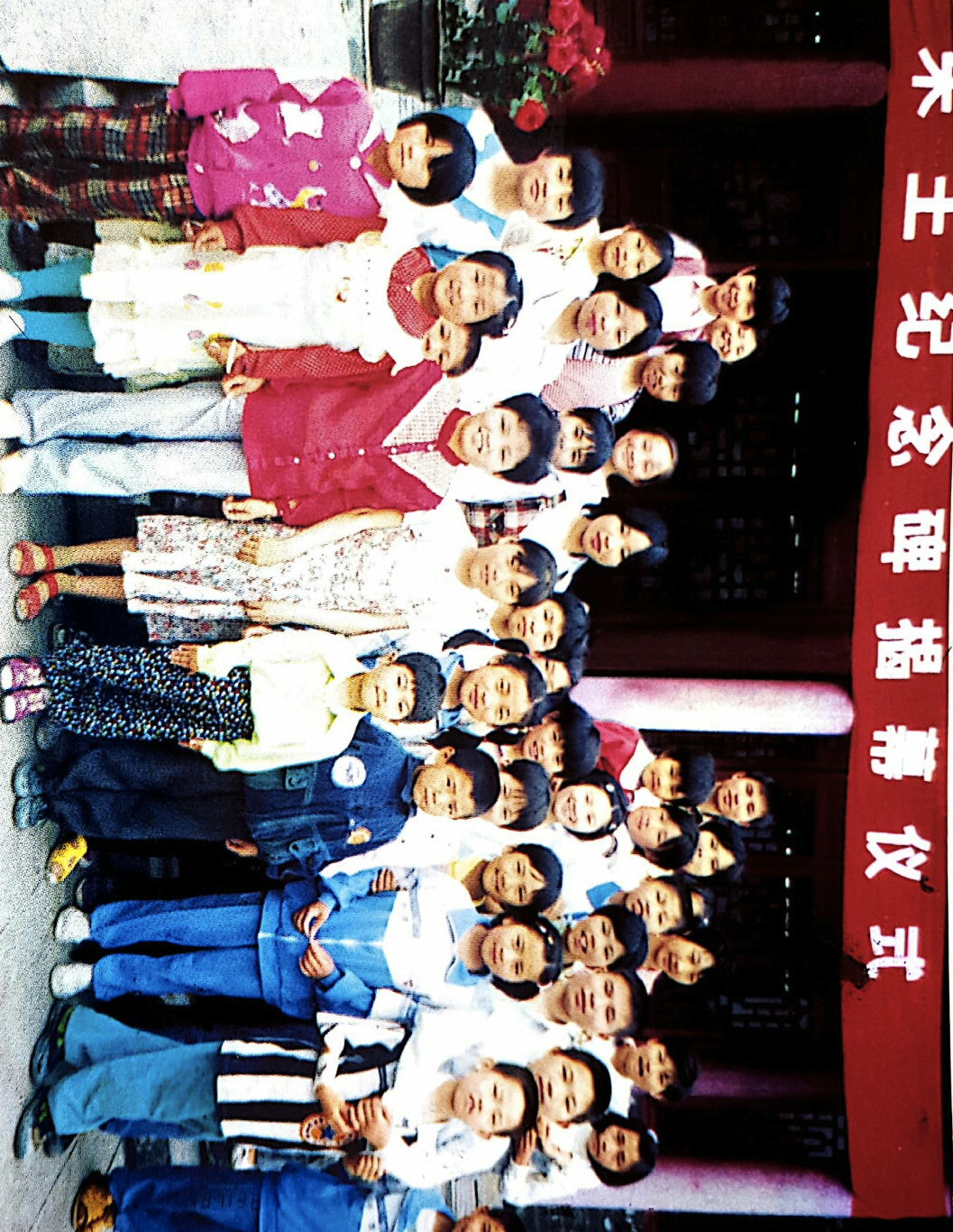
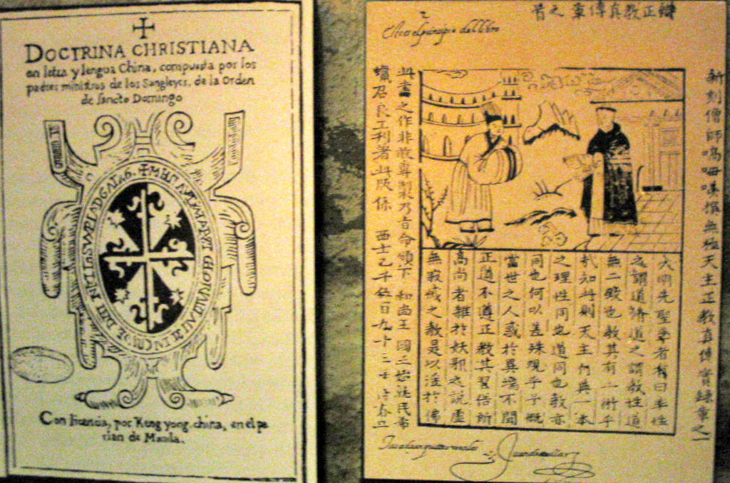
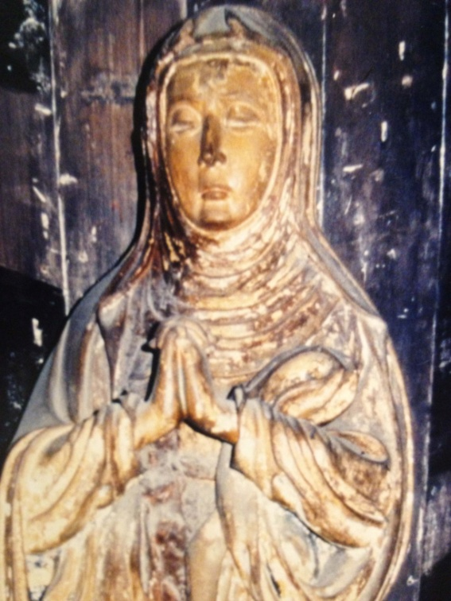
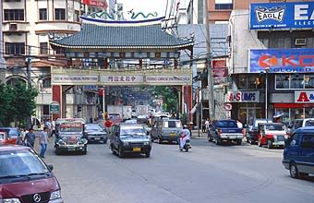
Migration and intercultural influences
  Despite colonial policies in PH, 16th to early 20th C migration left deep impact on culture, language, economy
  Oldest and biggest Chinatown in the world (est. 1594)
  Intermarriages were common
  1.2% of population identify as Chinese (89% from Fujian), about 27% with some traceable Chinese heritage

Slide 6
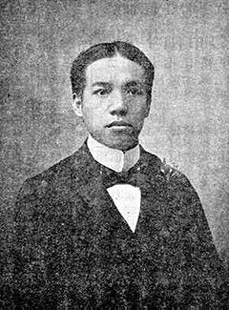
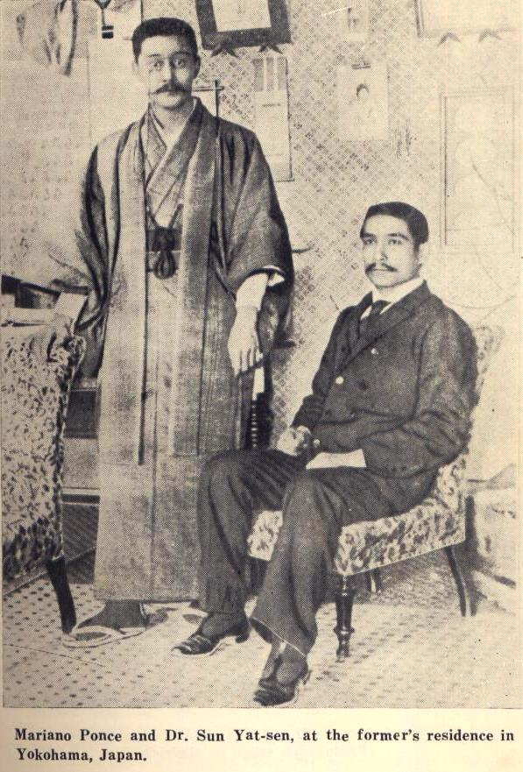
Parallel and intertwining political struggles
“The Filipino is a fellow Asian and my kindred. He has twice waged war against the white man, and never faltered despite difficult odds. To this I must kowtow and prostrate myself on the ground.”
-- Liang Qi Chao
Mariano Ponce and Sun Yat Sen met in Japan to discuss mutual support for each other’s revolution (against Spain and Qing) and Filipino-American war.

Slide 7

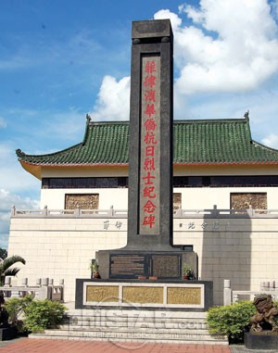
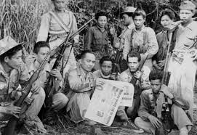
Wah Chi were Chinese guerillas in the Philippines, organized in 1942, who fought alongside Hukbalahap(People’s Anti-Japanese Army).
Gen. Jose Ignacio Paua (Hou Yabao) fought in Phil revolution
vs Spain and Philippine-American war. Lone foreign signatory of
Malolos Constitution, cut his queue after 1898 Filipino declaration
of independence.

Slide 8
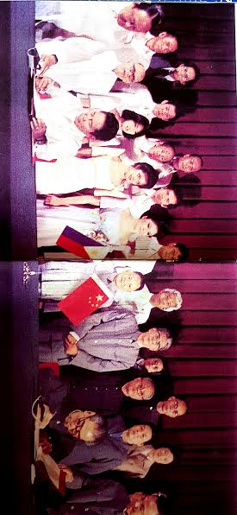
Normalization in 1975
Cold War, cold ties between states but continuing people-to-people links (many indirect)
1975 - China to respect PH independence and sovereignty, not to claim allegiance of ethnic Chinese, no subversion, no use of force to settle disputes
Philippines to uphold One China policy, mass naturalization of Chinese nationals, set ideological differences aside

Slide 9
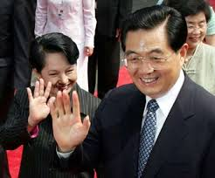
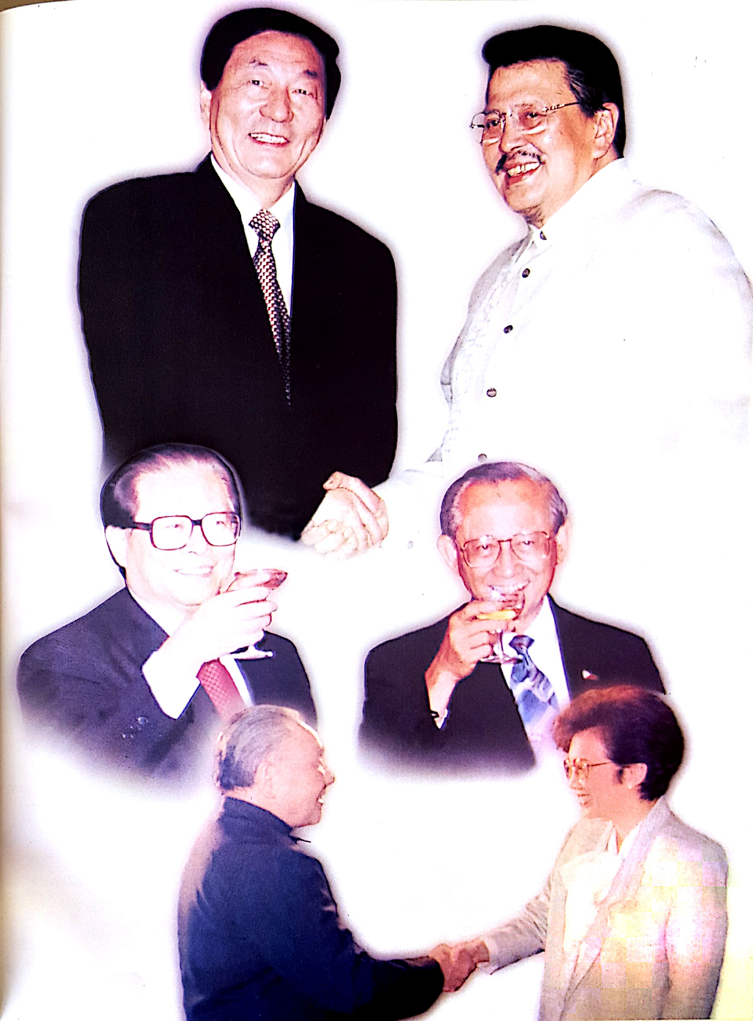
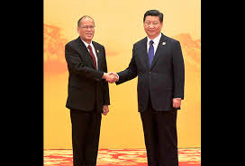

Slide 10
Highlights 1975-2015
1975 - 1986: Marcos and martial law years, active familiarization and cooperation
1986 – 1992: Corazon Aquino, post-people power inward focus, Taiwan’s diplomatic offensives, closure of US bases
1992 – 2000: Ramos/Estrada, post-Cold War regional adjustments to multilateralism, 1995-1999 maritime disputes, restoring military relations with US

Slide 11
2000 - 2010: Arroyo’s short-lived ‘golden age’, pragmatic approach, trilateral oil survey cooperation, corruption scandals, beginning of compliance with UNCLOS
2010 – present: Aquino III, ties dominated by territorial and maritime disputes with 2012 standoff, overlay of great power rivalry with China’s rise and US pivot

Slide 12
Active people-to people ties
Cultural Agreement, since 1979 and until 1990s among PH’s most extensive, created much good will on both sides
By 1999, over 200 S&T cooperation projects in rice production, TCM, flood control, hydro power, aquaculture, etc.
Tourism: China as fastest growing market
Role of non-state actors
  associations (APCU, PACS, PDRC)
  Filipino-Chinese community
  Filipino businesses as China opened up (especially in Fujian)

Slide 13
SISTER PROVINCES | SISTER CITIES
Albay-Lanzhou | Makati-Quanzhou
Bohol-Jiangxi | Quezon City-Shenyang
Cebu-Hainan | Cebu City-Xiamen, Hainan
Ilocos Norte-Shandong | Zamboanga-Quanzhou
Laguna-Fujian | Baguio-Hangzhou
Leyte-Hubei | Lapulapu City-Sanya
Nueva Ecija-Anhui | Iloilo City-Qingdao
 | Manila-Guangzhou

Slide 14
Trade between China and the Philippines (share in PH trade with Asia,%)
China has been among top trading partners since 2010. Close to Japan in 2014: 21.5%

Slide 15
Foreign Direct Investments

Slide 16
China has not been a major source of FDI
  Stock of Foreign Direct Investment from China: US$ 301 million (China reports US$593 – 2nd lowest in ASEAN)
  Stock of Foreign Direct Investment from HK: US$ 1,935 million
  Stock of Philippine FDI in China: US$ 545 million (China reports 2,892)
  Stock of Philippine FDI in Hong Kong: US$ 181 million
  Stock of Philippine FDI in the world: US$ 2,470
  UNCTAD, 2012

Slide 17
Top 5 Products Exported by the PH to China:
  Electrical products, copper cathodes, nickel ores and concentrates; other coal, copper ores and concentrates
Top 5 Products Imported by the PH from China:
  Electronics parts and accessories for office machines, liquefied petroleum gas, urea, ceramic products
Source: National Statistics Office of the Philippines

Slide 18
Approaches to territorial & maritime disputes
Asymmetric interests in SCS
  PH values economic resources, sovereign rights to EEZ, security
  For China, possibly strategic objectives- sovereignty, sea lines of communication, naval power projection, geopolitical rivalry with big powers

Slide 19
  Differences in political culture
    PH institutionalist (law and regional organizations), normative worldview, underdog mentality, shortsightedness
    China has realist disposition (material power), Sinocentric hierarchical worldview, victim mentality, farsightedness
  Power inequality
    Bilateral vis multilateral vis dual track

Slide 20
Elephant in the room – the U.S.
  PH view: alliance is part of hedging strategy (along with ASEAN diplomacy towards China), and needed for capability building for maritime security scenarios
  China view: U.S. is pursuing a strategy of containment of China, with the Philippines as a willing pawn

Slide 21
Managing crisis points in relations
Mischief Reef : immediate engagement on bilateral code of conduct talks, establishment of WG on Fisheries, Marine Environment Protection and Confidence-Building
Scarborough Shoal standoff : disruption of dialogue, failure of backchannels
Arbitration : most official contacts cut off; signals missed or misunderstood?
Effects of media on public opinion
New regional concerns over island construction activities

Slide 22
Observations
Have territorial tensions hurt economic relations?
  Resilience in economic relations due to interdependence
  Trade of both economies linked to global value chains where effects of disruption cannot be isolated to 2 sides
  But low level of economic ties means less compulsion to find more pragmatic solutions to political conflicts

Slide 23
Have territorial tensions hurt people-to-people ties?
  Public perceptions are highly negative towards other side, especially netizens (including ultranationalists, racists, jingoists)
  Some disruption in officially-facilitated linkages (e.g. travel advisory, cultural agreements)
  Multiple P2P contact points despite official snubs and efforts to isolate each other

Slide 24
Way forward
No armed conflict between China and the Philippines, both are committed to peaceful settlement in accordance with international law
Need for measures and mechanisms for building trust and assurance; both sides to step back from harsh rhetoric and further irreversible actions
Strengthen people-to-people exchanges, and develop public support on both sides for dialogue, mutual understanding
Noisy netizens notwithstanding, most Chinese and Filipinos are kind, respectful and hospitable people who have no conflict other than ‘what governments create’ and no appetite for conflict

