Slide 1
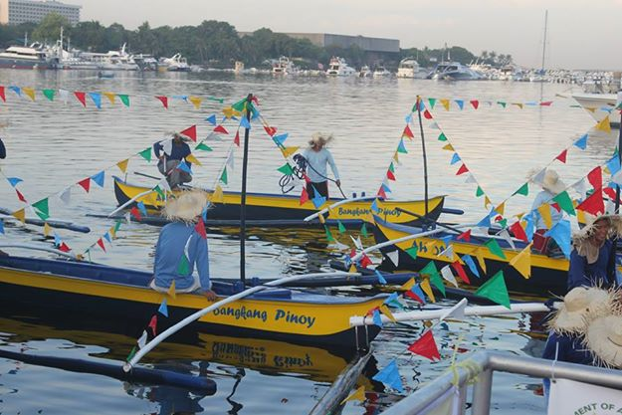
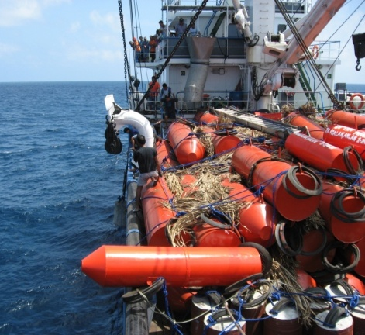
STATUS OF PHILIPPINE COMMERCIAL FISHERIES:
CHALLENGES, OPPORTUNITIES AND
GOVERNMENT PROGRAMS
ATTY. ASIS G. PEREZ
Undersecretary for Fisheries &
concurrent BFAR Director

Slide 2
Resources at a glance

Slide 3
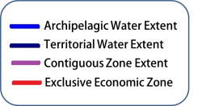
Philippine Waters
220 million has.
7x BIGGER THAN THE
TOTAL LAND AREA*
*Land Area: 29, 817, 000 has

Slide 4
MARINE RESOURCES
Shelf area (Depth 200m)
18,460,000 ha.
Coral Reef Area 2,700,000 ha.
8.81 % of the world’s coral reef next to Indonesia and Australia*
Coastline (Length)
36,289 km
Canada; Indonesia; Greenland; Russia; Philippines
Source: *UNEP, 2001

Slide 5
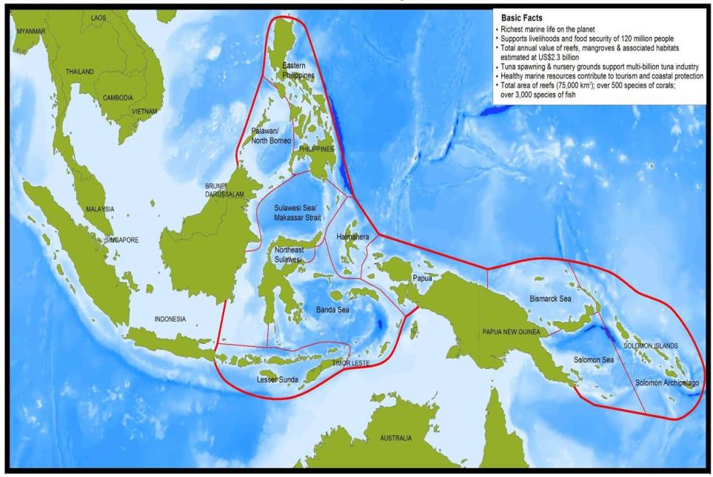
The Coral Triangle

Slide 6
…INLAND
*Fishponds: 253,854 ha
RESOURCES
*Swamplands: 246,063 ha
other inland resources 250,000 ha
Source: Philippine Fisheries Profile
*include freshwater and brackishwater
Notes:
Results of under staffing: 1. Inefficient collection of fishpond rentals 2. Poor enforcement 3. Less revenue for government

Slide 7
WORLD FISHERIES
PERFORMANCE
3rd
:
Produced a total of 1.75 million metric tons of aquatic plants (including seaweeds) or 7.36% of the total world production of 23.8 million metric tons (2012 data; SOFIA, 2014)
AQUATIC PLANTS
PRODUCTION
China; Indonesia; Philippines
11th
:
Produced a total of 0.791 million metric tons of finfishes, crustaceans, and mollusks which constitutes 1.24% share to the total global production of 66.63 million metric tons (2012 data , SOFIA, 2014)
Farmed Food-fish
PRODUCTION
China; India; Vietnam; Indonesia; Bangladesh
Norway; Thailand; Chile; Egypt; Myanmar; Philippines
12th
:
Produced a total of 2.13 million metric tons from marine capture fisheries or 2.67% of the total world marine capture production of 79.71 million metric tons (2012 data , SOFIA, 2014)
Marine Capture Fisheries
PRODUCTION

Slide 8
Contribution to the
NATIONAL ECONOMY -2014
Fisheries contribution to:
1. Total GDP
Current Prices = 1.6%
Constant Prices = 1.8%
Source: BAS

Slide 9
Contribution to the
NATIONAL ECONOMY -2013
2. GVA in Agriculture, Fishery and Forestry
Current Prices = 13.8 %
Constant Price = 18.2 %
Source: BAS

Slide 10
Contribution to the
NATIONAL ECONOMY
3. Employment
Aquaculture - 226,195
Municipal - 1,371,679
Commercial - 16,497
1,614,368
Source: NSO

Slide 11
Contribution to the
NATIONAL ECONOMY -2013
4. Balance of Trade
PARTICULARS | VOLUME (IN METRIC TONS) | VALUE (IN PHP MILLION)
Fishery Exports | 333,465 | 58,801
Fishery Imports | 262,161 | 12,859
Trade Balance | 71,344 | 45,942
Source: BAS

Slide 12
ECONOMICALLY-VALUED FISH SPECIES
1. Sardines
356,063.54 Metric Tons
Production (2014)
Source: Philippine Statistics Authority
PH Fisheries performance
www.bfar.da.gov.ph
/BFAR.Central
@bfarph

Slide 13
ECONOMICALLY-VALUED FISH SPECIES
2. Tuna
Production (2014):
374,760.93 Metric Tons
PH Fisheries performance
Source: Philippine Statistics Authority
www.bfar.da.gov.ph
/BFAR.Central
@bfarph

Slide 14
ECONOMICALLY-VALUED FISH SPECIES
2. Tuna Species
Bigeye tuna (Tambakol/ Bariles) | 11,161.09
Eastern little tuna (Bonito) | 35,514.03
Frigate tuna (Tulingan) | 134,094.98
Skipjack (Gulyasan) | 54,063.05
Yellowfin tuna (Tambakol/Bariles) | 139,927.78
Production in Metric Tons (2014)
PH Fisheries performance
Source: Philippine Statistics Authority
www.bfar.da.gov.ph
/BFAR.Central
@bfarph

Slide 15
ECONOMICALLY-VALUED FISH SPECIES
2. Tuna
EXPORT (2014):
117,909 Metric Tons
Total Fishery Export
37.21 %
Total Export Value
443,090 million USD
PH Fisheries performance
Source: Philippine Statistics Authority
www.bfar.da.gov.ph
/BFAR.Central
@bfarph

Slide 16
CHALLENGES
Impact of Typhoons to Production areas:
ST Yolanda Impact: 28%
TS Glenda, Ruby, Seniang and Amang: 25%
Regional/International Commitments to Curb IUUF
High Costs of Fuel and Feed Inputs
Production gains from Closed Seasons
Tuna Catch at HSP-1
GSP + Status in the EU Market
Eel: From Pest to Prime Export
AHON Initiative

Slide 17
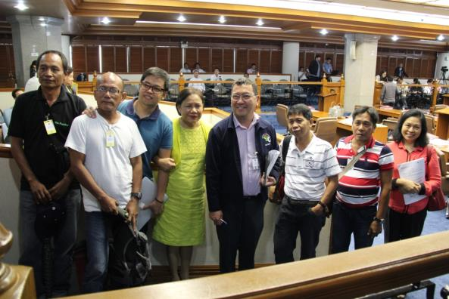
major accomplishments
Passage and signing of the amended RA 8550 by the Aquino administration
>GSP+ granted to PH by the EU
>Lifting of the “Yellow Card”

Slide 18
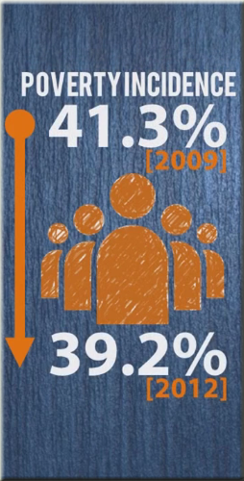
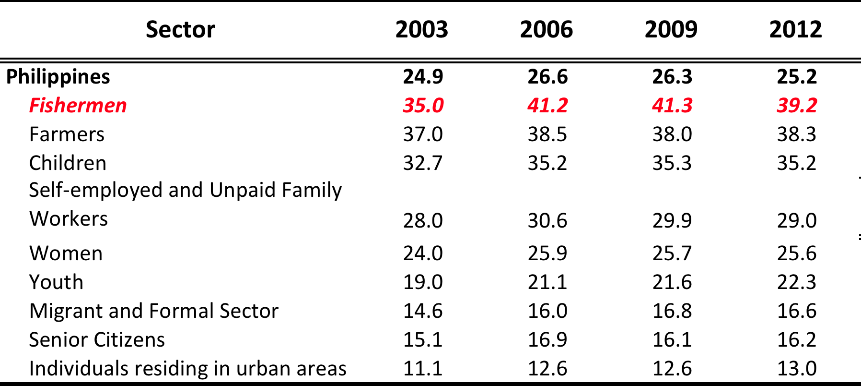
ACCOMPLISHMENTS
Poverty Incidence for Basic Sectors
Source: PSA-NSCB

Slide 19
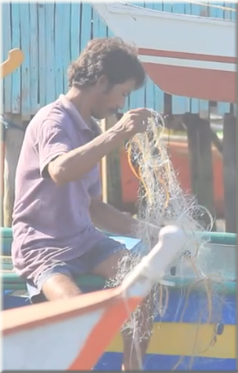
STRATEGIC DIRECTIONS FOR FY 2016
P
roviding TARGETed livelihood interventions to poor fisherfolk
S
ecuring livelihoods to reduce poverty and achieve inclusive growth
E
stablishing post-harvest facilities to reduce post-harvest losses
E
nsuring sustainability through intensified resource protection and management and resource enhancement.

Slide 20
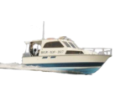
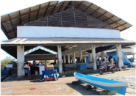
FISH PRODUCTION INTERVENTIONS
>Fish Cages
>Seaweed Farms
>Mussel/Oyster Farms
Municipality D
400/40
COASTAL MUNICIPALITIES
Fish Landing Centers
>
As post-harvest Facility
-Chest freezers
-Market stall
-Rainfall harvester
>Center for landing and auction
>Center for training (value-adding, marketing, etc.)
>Center for stock assessment/protection
Deployment of
Patrol Boats
MFRS DATA
Target 10% of fisherfolk population
Municipality F
700/70
Municipality C
1200/120
Municipality A
1000/100
Municipality E
1300/130
TARGETED ACTIONS TO REDUCE POVERTY AND
GENERATE ECONOMIC TRANSFORMATION

Slide 21
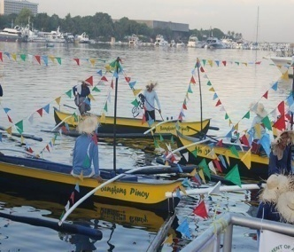
MAJOR INTERVENTIONS PER MAJOR FINAL OUTPUT

Slide 22
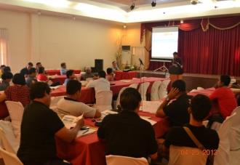
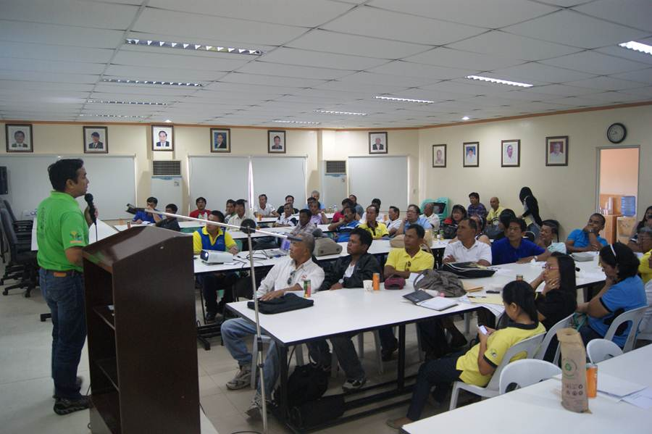
MFO 1: Fisheries Policy Services
Formulation of the IRR of RA 10654 (Amending RA 8550)
Continuous consultation with concerned stakeholders
Hosting of International & Local Workshops/Meetings and Conferences

Slide 23
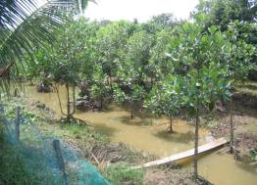
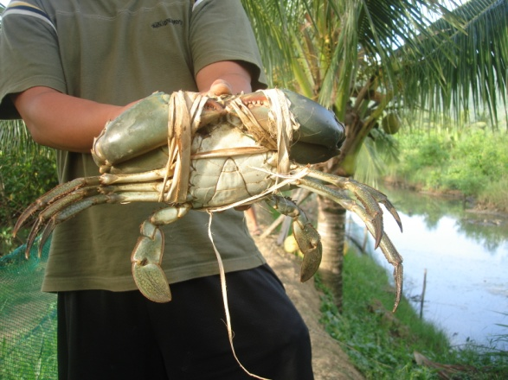
MFO 2: Technical Advisory Services
Utilization of mangrove replanted areas to intensify polyculture of crabs, grouper and other high-value species
Continued implementation of the Fisheries Scholarship Program
Promotion of Fish and fishery products in International Markets
Intensified Research and development programs
Strengthen Training capability of RFOs and PFOs
Provision of support to LGUs to complete the Boat and Gear Registration

Slide 24
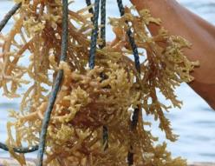
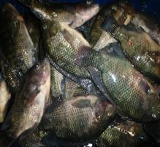
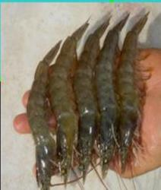
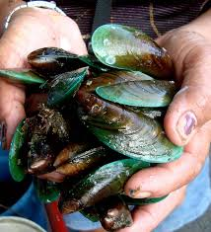
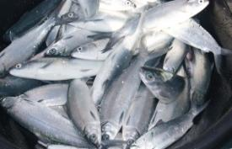
MFO 3: Supply Services for Fishery
Productivity
Provision of quality fingerlings and broodstock, and fishing gears and paraphernalia to TARGETed fisherfolk
Continued implementation of the Seaweed Development Program
Intensified promotion of improved culture technologies to boost shellfish production

Slide 25
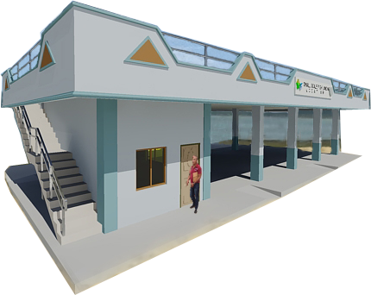
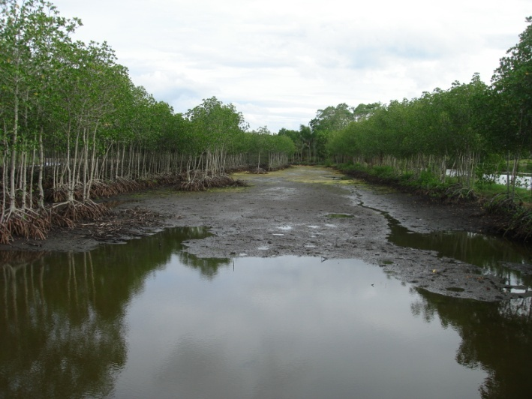
MFO 4: Supply of Infrastructure Facilities and
Equipment for the Fishery Industry
Establishment of 271 Community Fish Landing Centers which will serve as fish landing and auction hub, and training center
Promotion of community-based farming systems that maximize primary productivity in minor lakes and reservoirs through the Inland Fisheries Enhancement Program
Notes:
Hub for fish landing and auction
Venue for skills development training in post-harvest, value-adding and fishery conservation and resource management
An economic growth center for marketing and promotion of a “culturally distinct” value-added product of the community

Slide 26
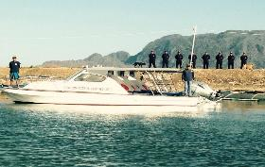
MFO 5: Fisheries and Aquatic Resources
Regulation Services
Intensified resource protection and management
Establishment of inter-relational management information systems: VMS, FLEMIS, FeLIS, FishR and BoatR
Strengthened visibility and capability of regulatory, inspection and law enforcement to carry out regional and international commitments

