Slide 1
New Chinese migrants in the Philippines and Southeast Asia: implications for international relations
Dr. Dai Fan
Associate professor, Institute of Southeast Asian Studies,
Jinan University, Guangzhou

Slide 2
I What is new Chinese migrants?
II Types of new Chinese migrant in Southeast Asia
III Impacts of new Chinese migrant
IV New Chinese migrants in the Philippines
V Some conclusions

Slide 3
I. What is new Chinese migrants?
Long history: Chinese immigration can date back to over one thousand years ago, namely Han and Tang dynasties.
The establishment of PRC in China and the suspend of normal Chinese outflow.
The reviving of Chinese immigration since the end of 1970s after China’s opening up an reform policy
Old migrants and new migrants

Slide 4
Definitions of International migrant
Department of Economic and Social Affairs Statistics Division (DESASD)
“An international migrant is defined as any person who changes his or her country of usual residence. A person’s country of usual residence is that in which the person lives, that is to say, the country in which the person as a place to live where he or she normally spends the daily period of rest. Temporary travel abroad for purpose of recreation, holiday, business, medical treatment or religious pilgrimage does not entail a change in the country of usual residence”.
International Organization for Migration (IOM) :
“Movement of persons who leave their country of origin, or the country of habitual residence, to establish themselves either permanently or temporarily in another country. An international frontier is therefore crossed. “

Slide 5
Definition of New Chinese migrant
New Chinese Migrants (NCM) refers to the Chinese who emigrated to others countries for long residence or business since the late 1970s. The people holding student visa, as well as China’s labor export staff and Chinese companies staff who are dispatched abroad are not included.
While the labors who overstayed and involved into the local labor market after their expiration can be seen as parts of migrants.
Some migrant workers, such as bus drivers, construction workers and prostitutes are not.

Slide 6
II. Types of new Chinese migrant in Southeast Asia
International migration occurs in a variety of ways and styles, and can be categorized into different types according to their legal status, economic status, profession, migration ways, scale, reasons, purpose, or even their origins and resources.

Slide 7
Types of NCM in Southeast Asia
 | Investment migrant | Retirement migrant | Skilled migrant | Amnesty migrant | Long-term Working | Chinese bride | Illegal migrant | Prostitute
Philippine | √ | √ |  | √ |  |  | √
Singapore | √ |  | √ |  | √ | √ |  | √
Thailand | √ | √ |  |  | √
Malaysia | √ | √ |  |  |  | √ |  | √
Myanmar, Cambodia, Laos, Vietnam |  |  |  |  | √ |  | √

Slide 8
Based on government’s migrant policy, migrants’ relationship with host country:
1. Philippine style
2. Singapore style
3. Other style

Slide 9
----Philippines style
Philippine is the only country that ever granted amnesty policy to illegal aliens and its migration policy is characterized by its human sympathy, high tolerance and flexible space for law enforcement.
In 1988, Philippines government initiated the amnesty program of Executive Order 314 to legalize those who entered the Philippines before 1984. (Suspended by the Congress in 1989 after a three-month implementation. )
On February 24, 1995, Republic Act 7919 was launched to grant legalized status to the aliens who entered the Philippines prior to June 30, 1992.

Slide 10
----Singapore style: migration country
Singapore attracts plenty of migrants and a third of the workers there are foreigners.
A person with professional or tertiary education background may be eligible for a one-year visa that allows him or her to move to Singapore to find a job, and he or she may be granted permanent residence right if they meet the requirements that Singapore government sets.
It is estimated that new Chinese migrant from mainland China that flow to Singapore after 1990, probably reaches 500-600 thousands, amounting 10-12% of the total population in Singapore.
The majority of new Chinese migrants are skilled migrants, professionals with good education background, as well as investment migrant.

Slide 11
William Zhu, CEO of a Hi-Tec company Ms. Liu in her restaurant

Slide 12
----Other style(may vary in different countries)
China’s economic relationship with SEA countries, and economic aid towards building transportation and resource-extraction infrastructure since 1990s leads to Chinese outflow.
This group includes professionals, students, petty traders, entrepreneurs, and both semi-skilled and unskilled laborers.
Cambodia : garment manufacturing is Cambodia’s preeminent industry and makes up 80% of the country’s total exports. Many factories registered with the Garment Manufacturers Association of Cambodia (GMAC) in mid-2013, are operated and owned by investors from Hong Kong, Taiwan, Singapore, and Malaysia, and hires plenty of new Chinese migrants as middle management staff, technical personnel and foremen.
Thailand: with the rising interest on Chinese language learning, many Chinese who speak fluent Mandarin are hired in Chinese language schools that blossom everywhere in Bangkok.
Malaysia: Chinese brides may be the largest
Besides, many girls from Vietnam, Thailand and China are engaging sex trade as prostitutes.

Slide 13
Chinese language school in Thailand

Slide 14
Chinese brides in Malaysia

Slide 15
III. Impacts of new Chinese migrant
----Singapore
It is well recognized that the Chinese migrants in Singapore have made a significant impact to Singapore’s progress in all levels of society.
Plenty of high-level positions in many fields, such as professionals including professors working for state universities, managers in company, are occupied by new Chinese migrants.
some associations mainly composed of new Chinese migrants are also engaged in the significant contribution to Singapore society.

Slide 16
Singapore
Hua Yuan General Association of New Immigrants

Slide 17
Negative impact:
Many people complain that their daily life have been affected by migrants, over-crowded MRT, long queuing line at lunch time, skyrocketing housing prices, and some new migrants’ bad behavior in public area led to wide political and social discontent
To quiet people’s sentiments, Singapore government’s migration policy has been adjusted, and more limitation on migrant is implemented to reduce and control immigration as a reverse to the old migration policy.

Slide 18
2.Other countries
Negative:
Rising property prices and cost of living has been a major concern for locals. Environmental degradation is another major problem in some SEA countries in light of mega projects like dams, power plants, mines and railroads.
Basically, new Chinese migrants will not compete with local workers in labor market, but their presence has heightened competition for market share and posed acute entrepreneurial challenges for local traders and small businesses in areas where they are concentrated.
Positive:
Job creation-the most immediate impact
In Cambodia, the expansion of employment in the garment industry and in construction has led to a shortage of labor in some areas of the country where paid employment has previously been scarce.
More Chinese investment
Promote international trade

Slide 19
IV. New Chinese migrants in the Philippines
1. Quantity and types
With the establishment of formal diplomacy of China-RP relations in 1975, a great deal of Chinese nationals again immigrated to the Philippines.
No official data on NCM in the Philippines.
Presently, Many related researches make an approximately same estimation of around 200,000 new Chinese migrants in the Philippines.

Slide 20
Types of NCM in the Philippines
Naturalization | Immigrants visa |  |  |  |  |  | Undocumented migrant
Republic Act 9139 | Amnesty program in 1998 | Republic Act 7919 on Feb. 24,1995 | Special Investor’s Visa | Special Resident Retiree’s Visa | Special Visa for Employment Generation | marriage | overstay

Slide 21
The data provided by the Philippine Bureau of Immigration showed that there are a total 44,355 legal Chinese citizens in the Philippines as of February 2008, 35,355 of whom hold immigrants visa.
Undocumented NCM:
----legal entry while overstayed. Some Chinese tourists or laborers overstayed their visa and engaged in employment as entrepreneurs or employees, especially as retail traders in Chinatown.
----”legalizing” by purchasing Filipino citizen birth certificate

Slide 22
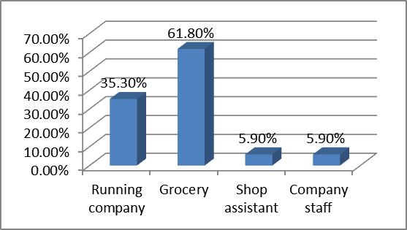
2. Occupation
168, Divisoria、Tutuban、 Baclaran、Quiapo……

Slide 23
Little by little, some NCM finally are successfully expanding their business and will engaged in other industries, such as manufacture, real estate….
It is said almost 70 percent of the whole Philippine goods are distributed from the wholesalers of Binondo-Divisoria areas, and many of them are Chinese businessmen.

Slide 24
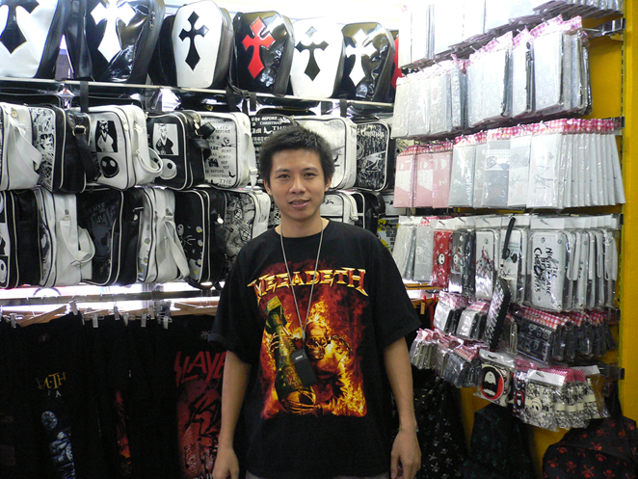

Slide 25
3. Influences: positive and negative
----Positive influence
First, massive cheap goods that meet the demand of Filipinos, especially the ones in low social level.
Second, job creation
Third, some NCM are devoting themselves into a wide range of enterprises from manufacturing, food industry, real estate to trade. It helps Philippines
Forth, social participation
NCM and the associations they are affiliated with, are willing to contribute to Philippines mainstream society.

Slide 26
There are three Chinese associations that are mainly or fully composed of new Chinese migrants, and they are Overseas Chinese Alumni Association of the Philippines (OCAAP-菲律宾旅菲各校友会联合会), Overseas Chinese Chamber of Commerce and Industry (OCCCI-旅菲华侨工商联总会), and Philippines Chinese Chamber of Commerce and Industry (PCCCI-菲律宾中国商会).
They are very active in helping the Philippines on disaster relief, free clinic, blood donation, firefighting, donating to orphanages, nursing homes, schools and churches.
As of Nov.27,2013, OCAAP has donated over 10 million Pesos which does not include materials and is still in increasing. As of Nov. 29, Chinese associations have donated over 100 million pesos for disaster relief.

Slide 27
Overseas Chinese Chamber of Commerce and Industry (OCCCI-旅菲华侨工商联总会)
First anniversary
Fifth anniversary

Slide 28
----Negative influence
Firstly, some new Chinese migrants are involving in criminal activities, such as smuggling, drug trafficking and tax dodging. It is wildly believed that tax dodging is a very common phenomenon in China town where many new Chinese migrant concentrate.
Second, NCM influx and the cheap good they are selling led to acute business competition, which forces some Tsinoy businessmen give up their traditional business and transfer to other field.

Slide 29
V. Conclusions: Implication for international relations
1.NCM in the Philippines and Singapore are more active in social participation.
Even in Singapore where government encourages NCM to integrate with mainstream society, their activities are mainly limited in social and economic field. They are still keeping away from politics.
As the first generation migration, most of them are still struggling for their family. Besides, they are still facing some obstacles in integrating with the local mainstream society.
2. As outsiders, they are more easily influenced by government-to-government relations rather than influence international relations. Though they love their home country and the host country they are based, neither do they have access or resource to politics, nor do they have interest on political participation. To be precisely, they are still “non-political animal”.
Anyway, just give them time and policy space, they will do better little by little, which finally helps the host country.

Slide 30
Thanks!

