Slide 1
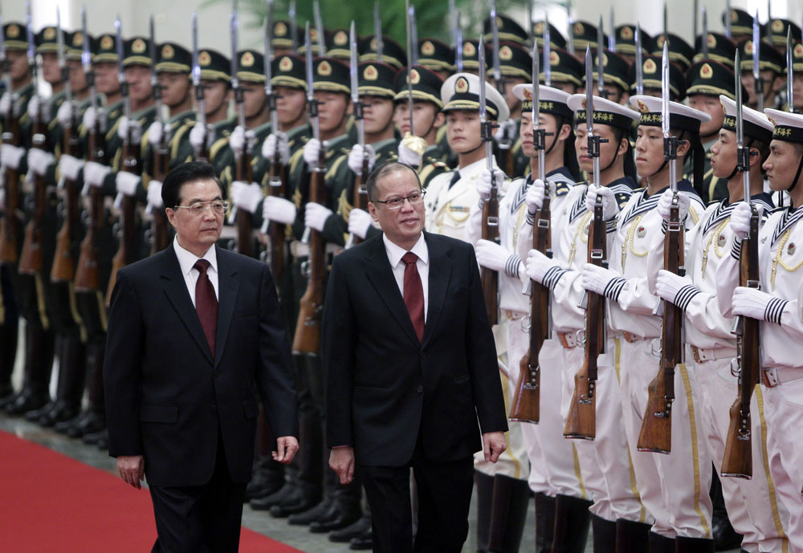
Cultural Gaps between the
PHILIPPINES & CHINA

Slide 2
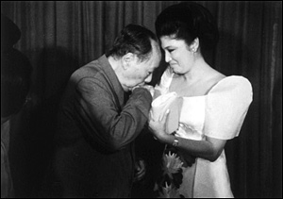

Slide 3
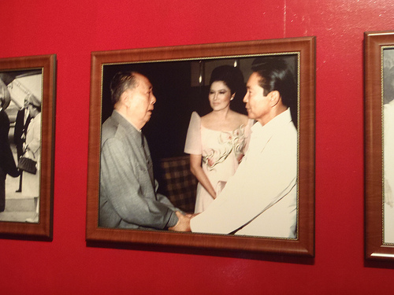

Slide 4
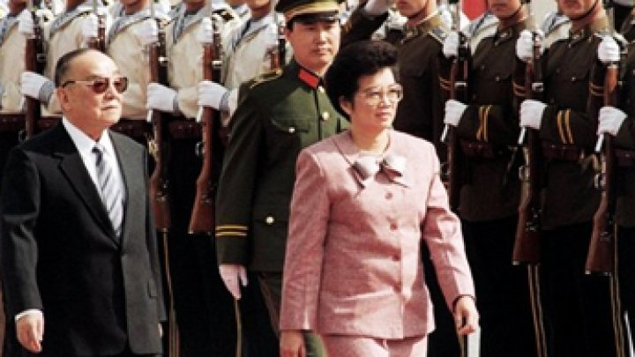

Slide 5

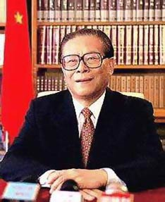

Slide 6
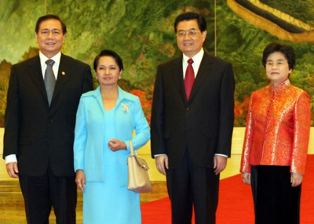

Slide 7
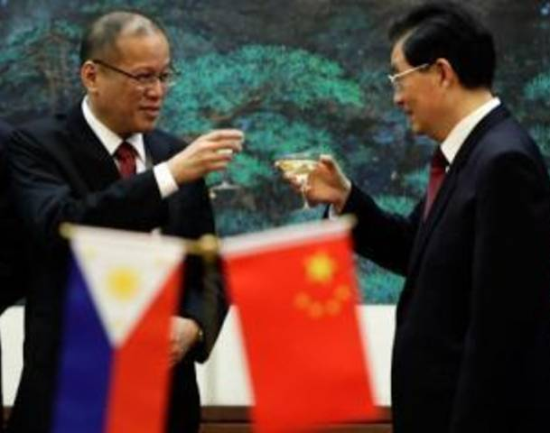

Slide 8
“WAR OF WORDS”
Bilateral dispute initially took the form of diplomatic protests & maritime encounters
But a “war of words” also broke out between the media in China & the Philippines

Slide 9
PHL-CHN PERCEPTIONS
Big gaps in perception: PHL views CHN as “bully” who resorts to “coercion”
CHN views PHL as “trouble-maker” who acts as “pawn” & “Trojan horse” in US strategy to contain China

Slide 10
IMPACT ON PUBLIC OPINION
Social Weather Stations (SWS): it has conducted quarterly surveys on China trust rating in the Philippines since 1994
SWS survey: based on interviews with a random sample of 1,200

Slide 11
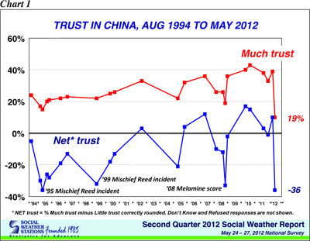

Slide 12
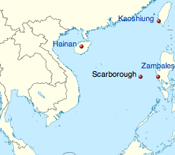
SCARBOROUGH SHOAL

Slide 13
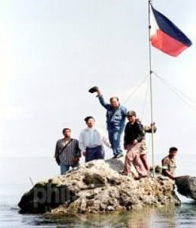
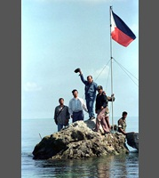
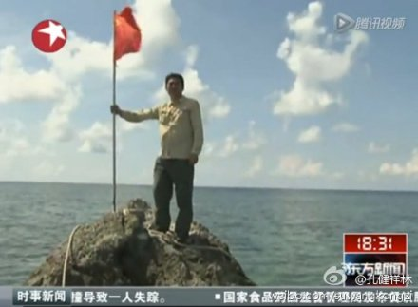
SCARBOROUGH SHOAL

Slide 15
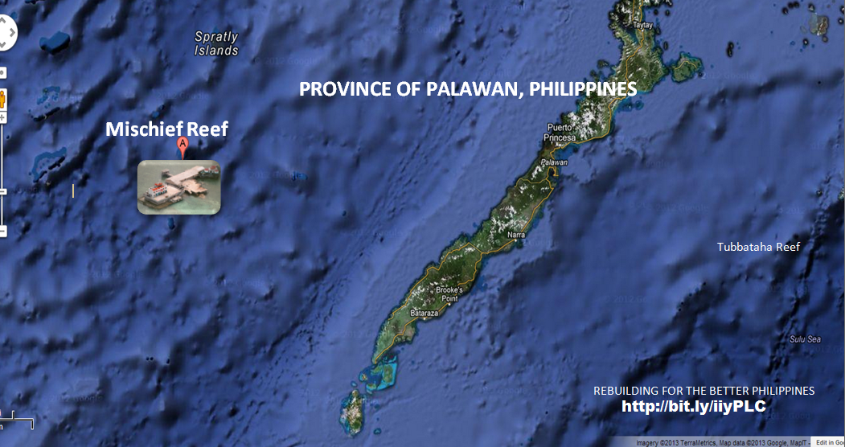
MISCHIEF REEF

Slide 16
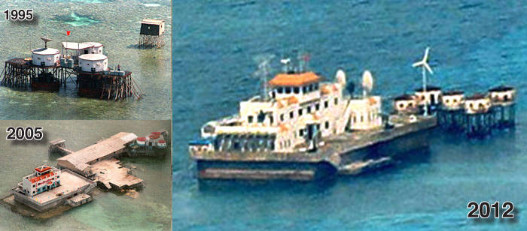
MISCHIEF REEF

Slide 18
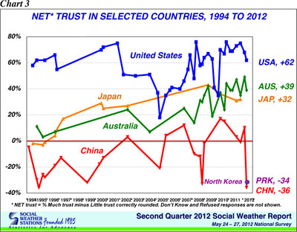

Slide 19


Slide 20
PEW SURVEY (2013)
PHL survey: based on interviews with a random sample of 804
CHN survey: based on interviews with a random sample of 3,226
Surveys conducted March-April 2013, margin of error: 3.5 to 4.5

Slide 21
IMPRESSION OF CHINA
48% of Filipinos: unfavorable impression of China, up from 30% in 2002
39% of Filipinos considered CHN as an “enemy,” while 22% viewed CHN as a “partner”

Slide 22
PHL-CHN DISPUTE
90% of Filipinos viewed territorial dispute with China as a “big problem”
68% considered China’s growing military power as a “bad thing” for the Philippines

Slide 23
USA OR CHINA?
77% of Filipinos: in favor of strong ties with the USA
6% in favor of strong ties with China
13% in favor of strong ties with both USA & China

Slide 24
US-CHINA RELATIONS
Views on US-China relations:
32% of Chinese: cooperative
23%: hostile
31%: neither cooperative nor hostile
15%: no opinion

Slide 25


Slide 26
HORIZON SURVEY (2012)
China survey: based on interviews with a random sample of 3,775
Survey conducted Dec 2011-Jan 2012, margin of error: plus or minus 1.7 percentage points

Slide 27
CHINESE VIEW OF USA
52% of Chinese: US seeks to prevent China from becoming a great power
27%: US accepts China as a rising power, seeks cooperation
21%: Not sure

Slide 28
US MILITARY PRESENCE
50% of Chinese opinion leaders viewed US military presence in Asia-Pacific region as leading area of concern for potential US-China conflict
38%: Taiwan issue as second area of concern

Slide 29



Slide 30
QQ.COM ONLINE SURVEY
Should China extend assistance to the Philippines?
84% said NO
16% said YES
Total # of respondents to online survey: 203,764

Slide 31

92% of Chinese netizens opposed extending aid to the Philippines
Total # of respondents: 5,000

Slide 32
GLOBAL TIMES
Commentary, Nov 12, 2013:
“If it snubs Manila this time, China will suffer great losses…We call for extending disaster-relief assistance to Philippine victims, but it doesn’t affect our stand on the South China Sea issue.”

Slide 33


Slide 34
CONCLUDING REMARKS
Big gaps in public attitudes exist in the Philippines & China due to “war of words” resulting from bilateral dispute
Huge challenge for gov’ts & media to bridge these gaps

